Slide 1
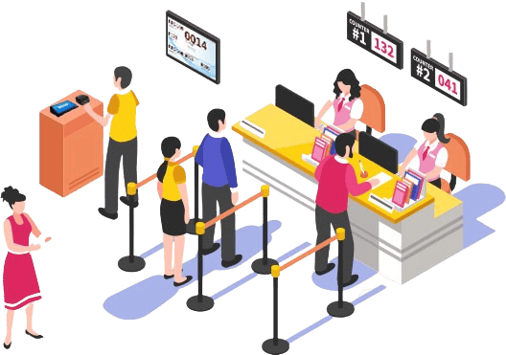
♧ Web Programming
QueueLess
Queue Management System
Domain: Web Development
Name : Gayathri Jayam S
Roll No: 240701142
1

Slide 2

♧ Web Programming
ABSTRACT
View queue details
Show token details and whether a token is waiting or being served.
QueueLess is a web-based queue management system developed to simplify queues in offices, laboratories and service centers. Users can view available services, obtain queue tokens and check their token status. The system displays waiting tokens and the people currently being served, helping users understand the queue without having to wait blindly.
View services
Display available services and the number of people waiting.
Staff controls
Allow staff to call the next token and pause service when needed.
2

Slide 3
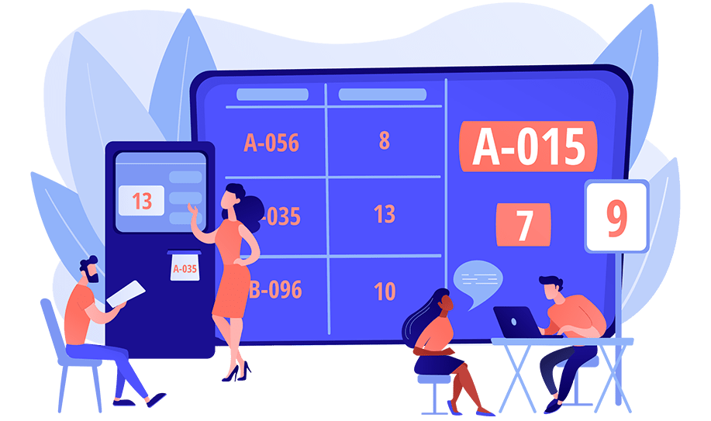
♧ Web Programming
Software and
Hardware Requirements
› Software
› Hardware
›
Visual Studio Code
›
Intel Core i3 or equivalent
›
Node.js and npm
›
Minimum 4 GB RAM
›
Google Chrome
›
At least 1 GB free storage
3

Slide 4
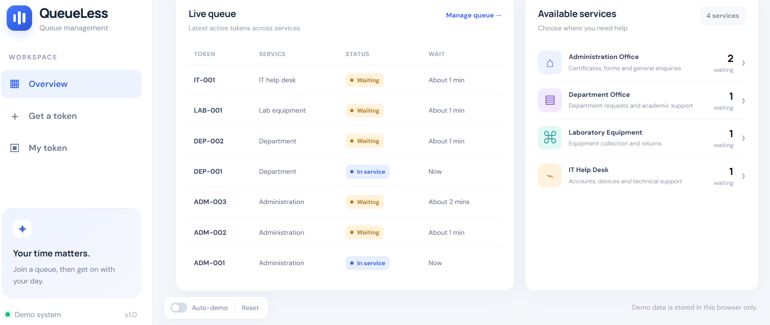
♧ Web Programming
FULL VIEW OF THE PROJECT
The overview page shows the live queue and the services currently available to users.
4

Slide 5
♧ Web Programming
Sampe Coding
SAMPLE CODING
Example logic for selecting the next waiting token.
function callNextToken(queue) {
const nextIndex = queue.findIndex(
token => token.status === "Waiting"
);
if (nextIndex === -1) return queue;
return queue.map((token, index) =>
index === nextIndex
? { ...token, status: "In service" }
: token
);
}
Find next token
Finds the first token with Waiting status.
Update status
Changes the selected token to In service.
5

Slide 6
♧ Web Programming
ARCHITECTURE DIAGRAM
The main parts of the current browser-based prototype are shown below.
User interface
Queue logic
Browser storage
Overview, Get a token, My token and Staff console.
Creates and updates tokens and tracks queue status.
Stores demo data in the current browser.
The interface responds to user actions, updates queue information and keeps demo data in the browser. This version does not show a separate server or database.
6

Slide 7
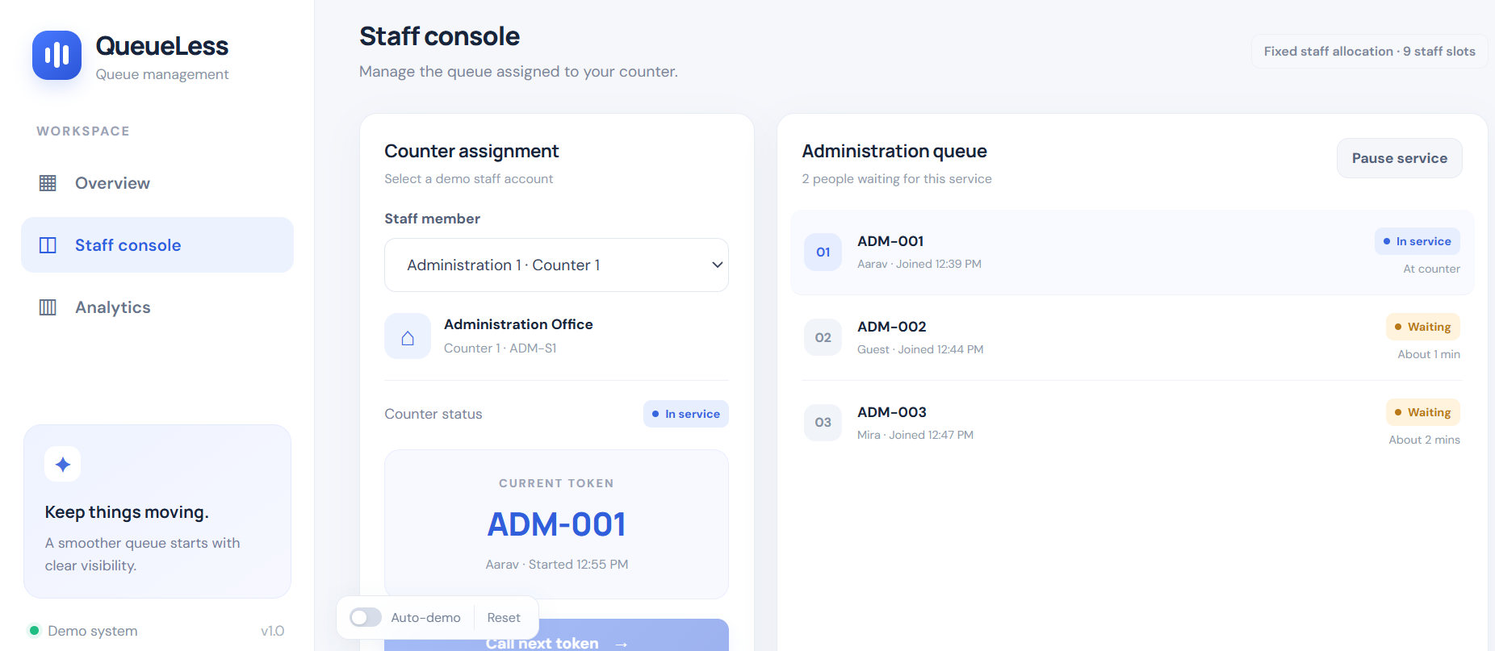
♧ Web Programming
PROJECT DEMO: STAFF CONSOLE
The staff console shows the selected counter, current token and people waiting.
7

Slide 8
♧ Web Programming
DEMO OF THE PROJECT
The project can be demonstrated in the following order:
›
Open Overview to show the live queue and available services.
›
Select Get a token and choose the required service.
›
Open My token to show the token number and status.
›
Go to Staff console and select a staff member or counter.
›
Click Call next token and show the queue status update.
8

Slide 9
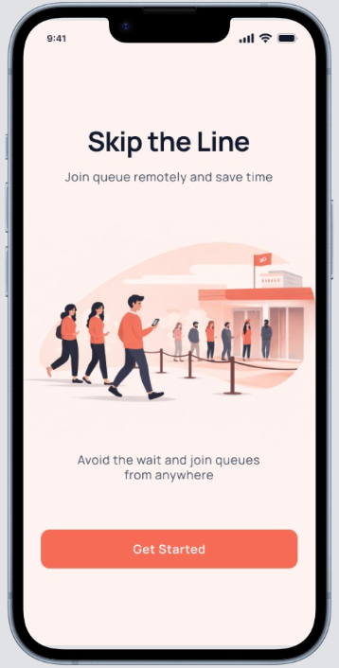
♧ Web Programming
CONCLUSION
QueueLess provides a simple way to view service queues and manage tokens through a web interface.
›
Users can view services and check token status.
›
Staff can monitor waiting tokens and call the next person.
›
Future improvements may include login, a database and live updates.
9

